Slide 1


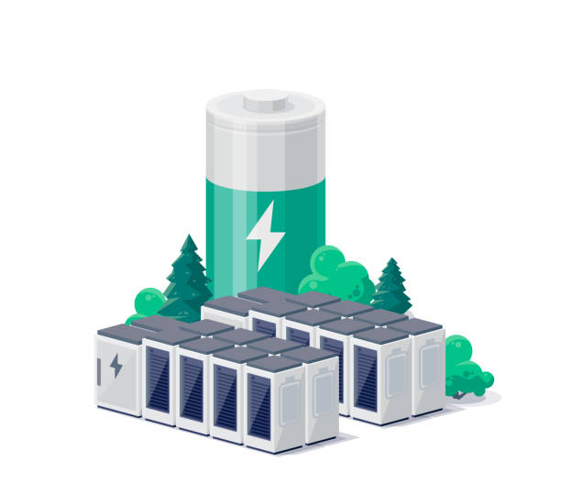

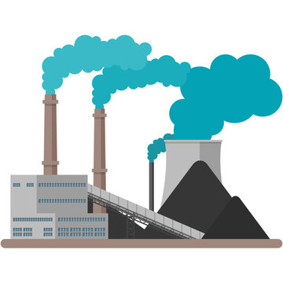

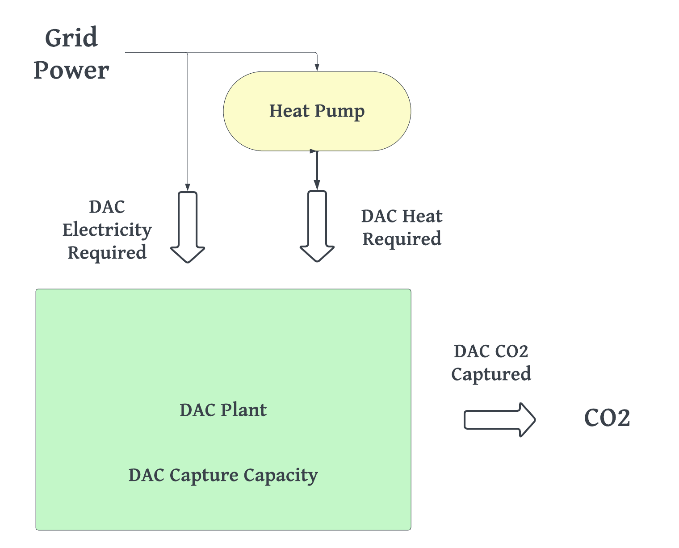
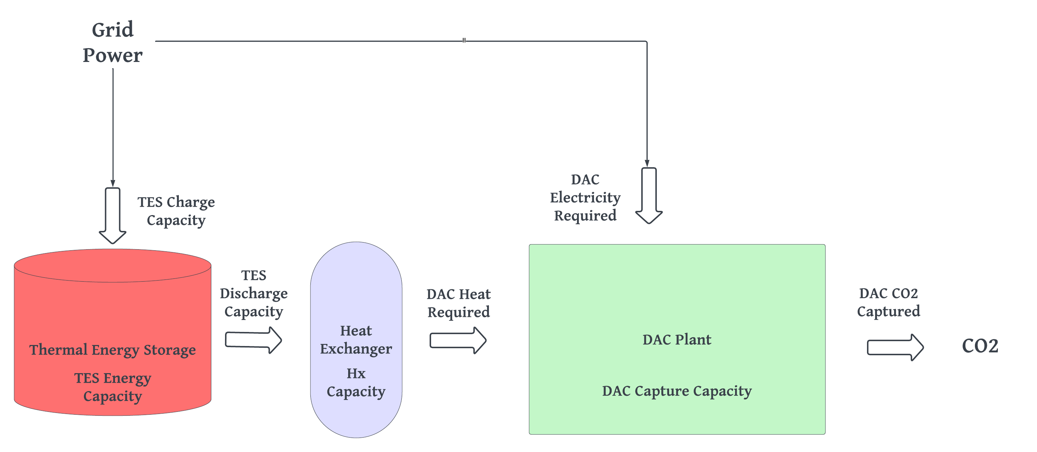
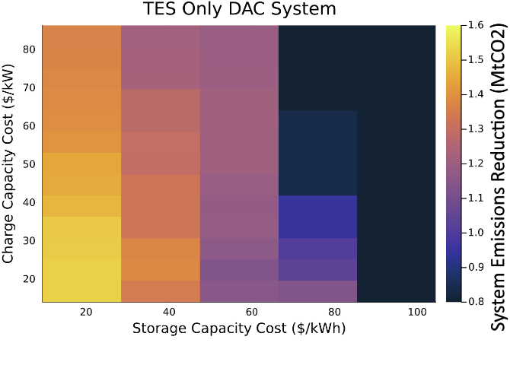
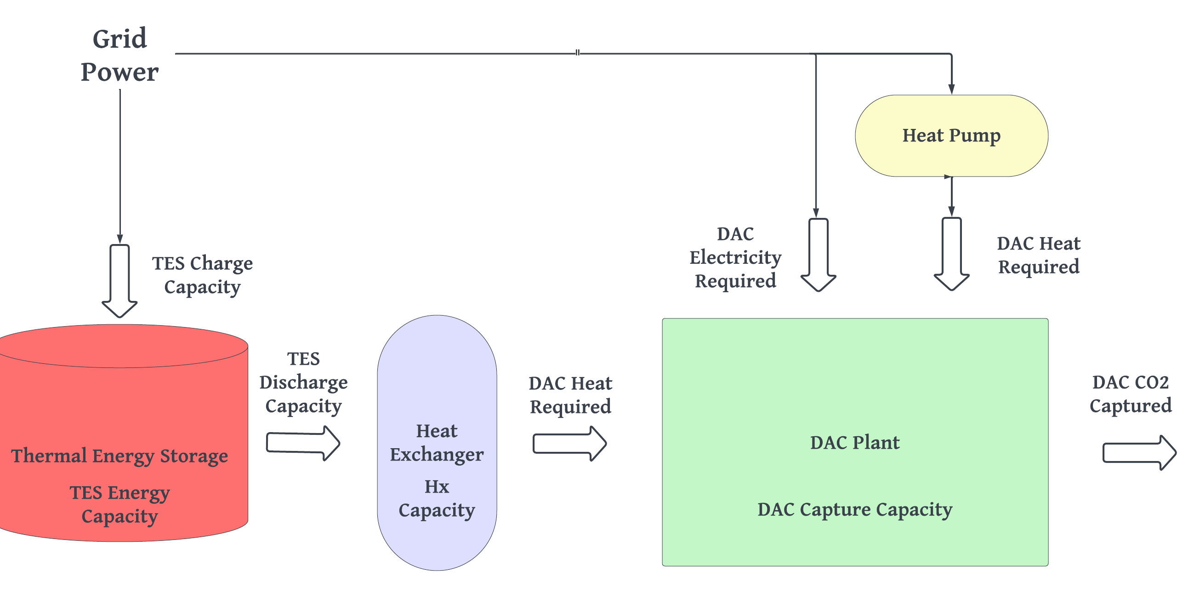
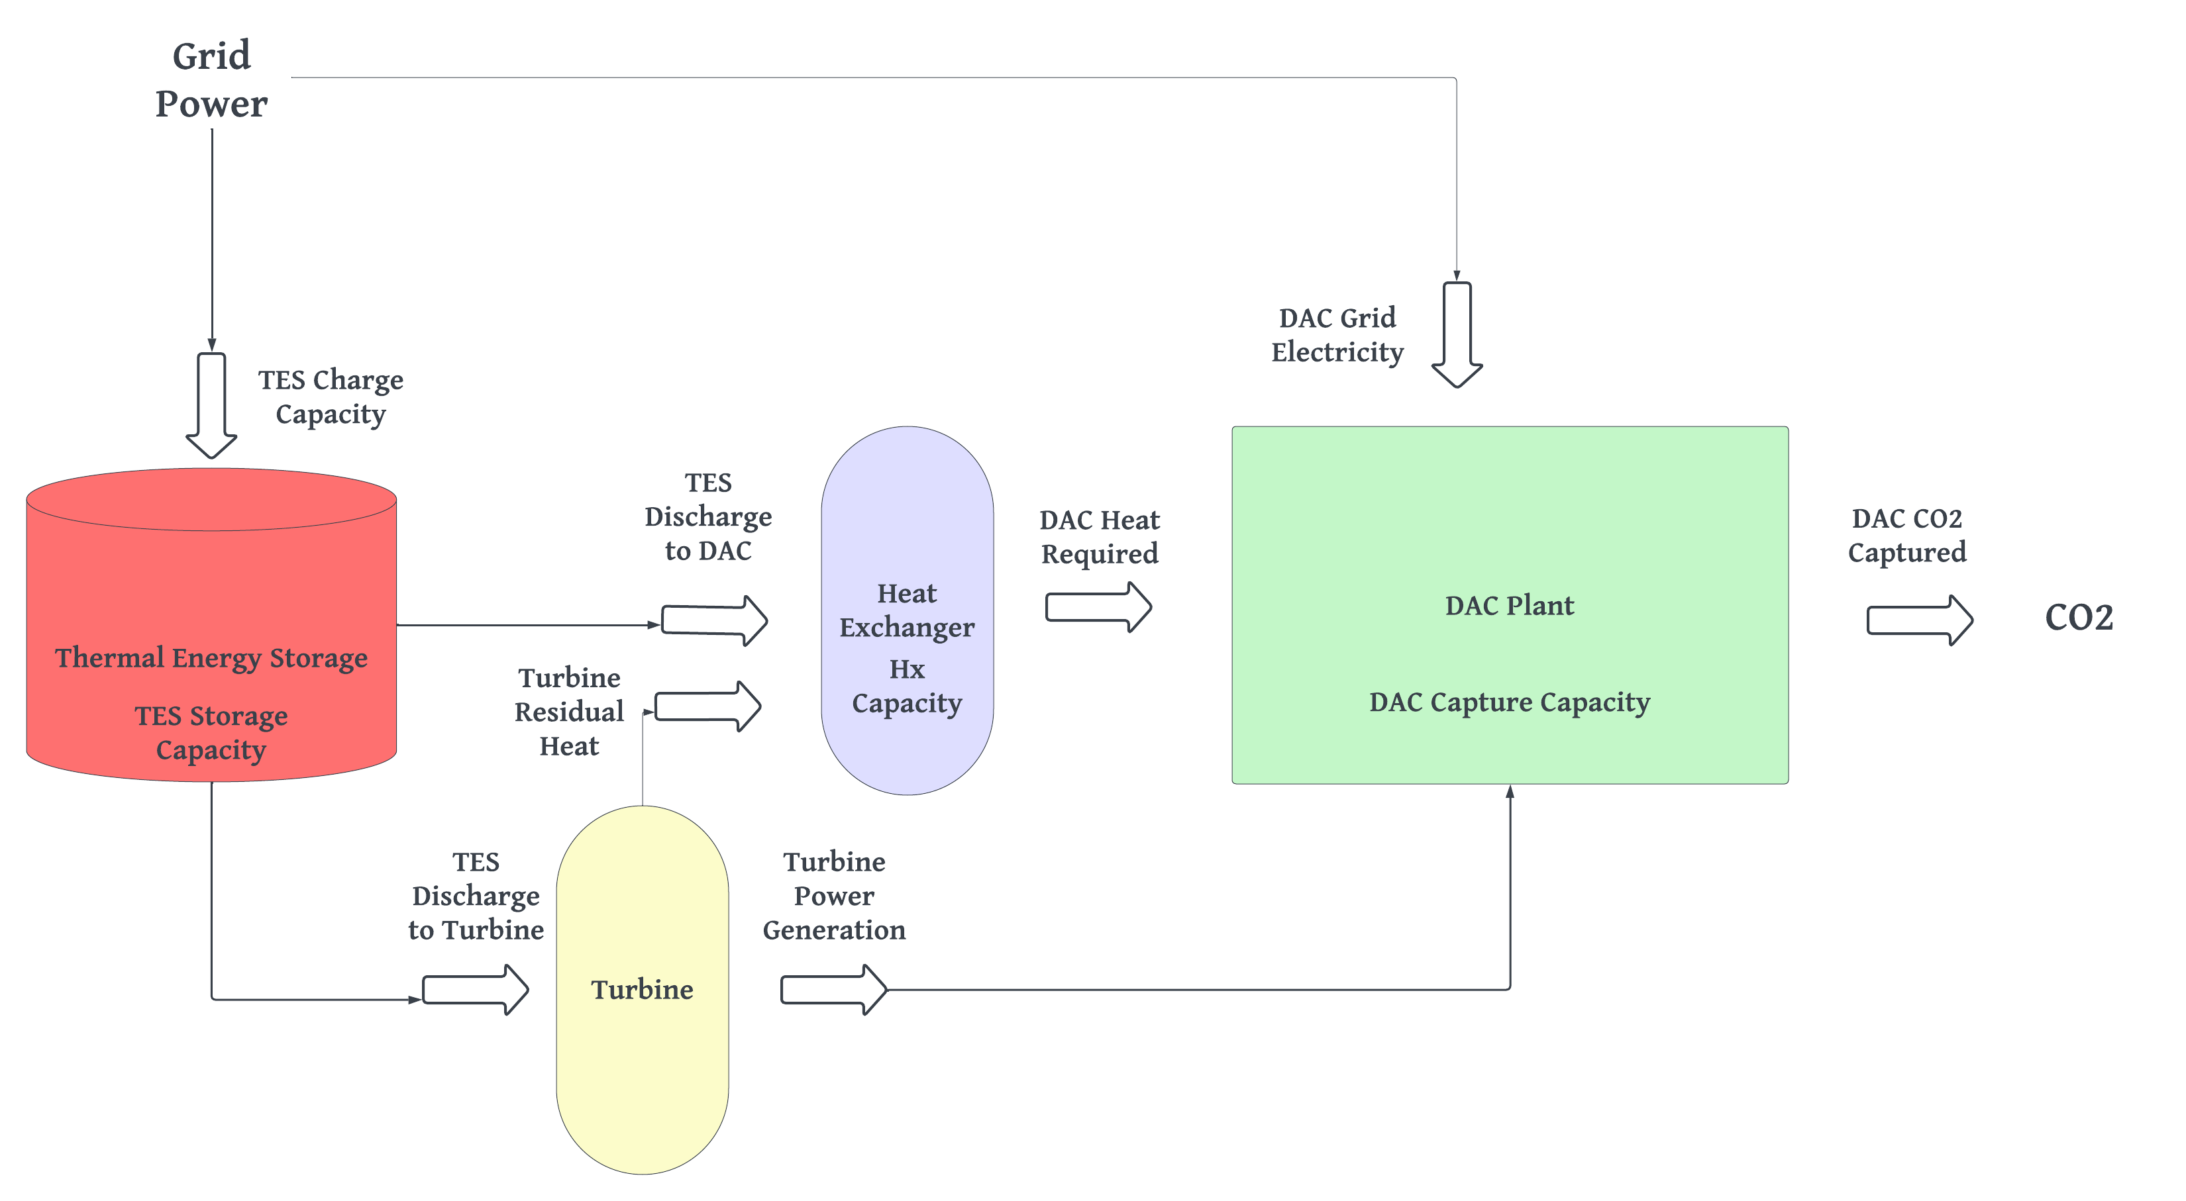
How to Power Direct Air Capture? Modeling System Wide Emissions Reduction of Direct Air Capture with Thermal Energy Storage
Vinay Konuru¹, Aniruddh Mohan², Kelsey Hatzell², Jesse Jenkins²
1. Department of Electrical and Computer Engineering, Princeton University
2. Andlinger Center for Energy and the Environment, Princeton University
Background and Context
Overview
Key Findings
Direct-Air Carbon Capture (DAC) is one of the lowest cost technologies to decarbonizing hard-to-abate industries
Question: How do we consistently supply clean power and heat?
Hypothesis: Thermal Energy Storage can reduce operational emissions by storing clean heat
Technical constraints: 100C sorbent regeneration
Economic constraints: High capital cost, low flexibility
Policy constraints: CO2 Capture Targets
In this study, we’ve explored the capability of thermal energy storage to reduce the operational emissions and increase the system-wide emissions reductions of DAC plant by answering the following questions:
How do the plant-level cost of DAC increase with co-locating TES relative to other heating solutions?
To what degree do the system-wide emissions change in systems with DAC co-located with TES?
How would cost reductions in TES drive the synergy between these technologies?
Key finding 1: Plant level cost of CO2 capture is reduced by $100/tCO2 with TES
Gas + Grid
TES
DAC
Key finding 2: System level cost of CO2 capture is reduced by $300/tCO2 with TES
+
Technology Overview
Plant Design Configurations
Heat Pump Pros: Low fixed costs High heat generation efficiency Cons: No flexibility | Thermal Energy Storage Pros: Flexibility in heat production Cons: High fixed costs
Heat Pump + Thermal Energy Storage Pros: Smaller TES Cons: Lower heat storage capacity | Thermal Energy Storage + Turbine Pros: Energy security Cons: High fixed costs
1
2
Key finding 3: System emissions reductions are driven by reductions in TES capacity cost
3
4
Experimental Setup
Conclusion & Future Work
Plant
Solid Sorbent
Grid-Connected
1MtCO2 Annual Capacity
System
ERCOT
2-Zone System
DAC in East Texas
Thermal energy storage shows great potential for improving the system-wide emissions reductions of DAC, but policy regulations will need to motivate the development of co-located DAC + TES plants to help overcome the early high plant level costs. This can be done through tax incentives or renewable energy procurement rules, which are meaningful areas for future research.

